Slide 1
Case study
Mr. Wong is a 50-year old male, sales representative who travels often
BP 150/90 mmHg
Medications: atenolol 50mg daily, lisinopril 10mg daily
Resting HR: 60/min
170cm, 84kg , BMI 29
His brother just suffered from MI at age 40.
Concerned about his health
Want to do start exercise and lose weight

Slide 2
Evaluation
Classify client according to Risk Stratification Criteria
ACSM/ ACP/ACCVPR/ AHA
Identify Major Coronary Artery Disease Risk Factors
Identify signs or symptoms suggestive of cardiopulmonary disease
Identify secondary risk factors
Obesity, alcohol consumption, stress levels

Slide 3
Consider the following criteria during your evaluation:
Age and gender
Moderate Vs vigorous exercise program
Physician present during testing
Submaximal or maximal graded exercise test
Type of test (treadmill, leg ergometer, step)
Absolute and relative contraindications to exercise testing

Slide 4
What recommendations in reference to medical examination and testing prior to participation in an exercise program?
A. Medical examination and exercise testing
B. Physician Supervision of exercise test

Slide 5
Positive Risk Factors for CHD ACSM (2006)
Family History
Myocardial infarction, coronary revascularization (bypass surgery) or sudden death before :
the age of 55 years in father or other male first degree relative (i.e. brother or son)
the age of 65 years in mother or other female first degree relative (i.e. sister or daughter)
Cigarette smoking
Current cigarette smoker or those who have quit in the last six months
Hypertension
Client on Hypertensive medications
Resting SBP > 140 mmHg and/ or DBP > 90 mm Hg
Fasting Glucose
Fasting blood glucose of >100mg/dL 5.6mmol/L)

Slide 6
Positive Risk Factors for CHD ACSM (2006)
Dyslipidemia
Total serum cholesterol > 200mg/dL (5.2 mmol/L) or
High density lipoprotein (HDL) < 40mg/dL (1.03 mmol/L)
Low density lipoprotein (LDL) > 130mg/dL (3.4mmol/L)
Obesity
Body Mass Index (BMI) > 30 kg/m² or
Waist girth >= 102 cm (M); >= 88 cm (F) or
Waist/hip ration >= 0.95 (M); >= 0.86 (F)
Sedentary Lifestyle
Not participating in a regular exercise program
Accumulating less than 30 minutes moderate intensity exercise 3-5 days weekly
Negative Risk Factors for CHD ACSM (2006)
High level of HDL
HDL cholesterol > 1.6 mmol/L (60 mg/dl)

Slide 7
Initial Risk Stratification
Low risk
Men<45 years of age and women <55 years of age
Younger individuals who are asymptomatic and meet no more than one risk factor threshold
Moderate risk
Older individuals (men≥ 45 years of age; women ≥ 55 years of age) or those who meet the threshold for two or more risk factors
High Risk
Individuals with one or more signs/symptoms or known cardiovascular, pulmonary, or metabolic disease

Slide 8
ACSM Recommendations for: (A) Medical Examination and Exercise Testing Prior to Participation, and (B) Physician Supervision of Exercise Tests
Low Risk Moderate Risk High Risk
A.
Moderate exercise NN NN R
Vigorous exercise NN R R
B.
Submaximal test NN NN R
Maximal test NN R R
NN - Not Necessary R - Recommended

Slide 9
Hypertension and Exercise Position Stand (Evaluation)
Supervised exercise stress test
High intensity exercise program (VO2 R >60%)
Patients with TOD/DM or BP >180/110 before engaging in moderate-intensity exercise (VO2R 40 to 60%)
Patients with CVD (stroke, heart failure, IHD)
Avoid high intensity exercise (vigorous program best initiated at dedicated rehabilitation centre)

Slide 10
Questions
Please write an initial exercise prescription
Any adjustments and practical tips in patients with HT?

Slide 11
 | Aerobic Activity |  |  | Muscle-Strengthening Activity
Recommendation | Frequency | Intensity | Duration | Frequency | Number of Exercises | Sets and repetitions | Flexibiltiy/Balance
Hypertension, 2004 (ACSM Recommendation) | Most, preferably all days per week | Moderate intensity at 40 -<60% of VO2max reserve (vigorous intensity acceptable for selected adults) | Accumulate 30 - 60 min/d of moderate-intensity activity, in bouts of at least 10 min each; | 2-3 d/wk (resistance training an adjunct to aerobic activity) | 8-10 exercises involving the major muscle groups | 1 set of 8-15 repetitions (more than 1 set acceptable for selected adults)
Cholesterol, 2001, National Cholesterol Education Program | Most days of the week, preferably daily | Moderate intensity | At least 30 min/d | Muscle-strengthening activities recommended as beneficial |  |  | Flexibility regarded as beneficial

Slide 12
ACSM Recommendation for Hypertension
40-70% of VO2max, i.e. 55-80% of the maximal heart rate. The lower range of intensity is sufficient for the elderly.
3 or 4 times weekly for at least 30 minutes at a time
Various endurance exercise modes are suitable. Resistance training (preferably circuit training) should not be the only form of exercise but should be combined with endurance training.
Training at an intensity of about 50% of the maximal exercise performance (moderate-intensity) is sufficient with regard to resting blood pressure reduction (Fagard, 2001).
Finnish Medical Society Duodecim. Physical activity in the prevention, treatment and rehabilitation of diseases. 2004 Apr 20

Slide 14
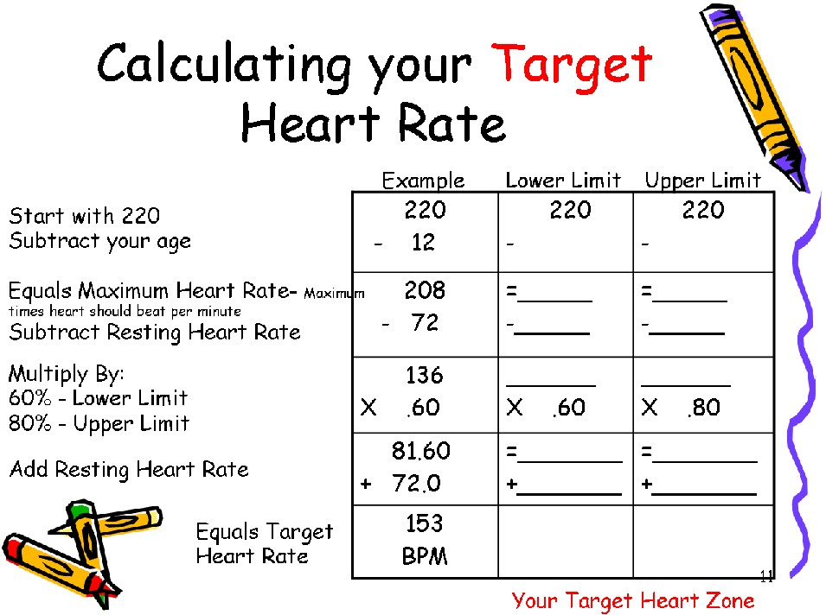

Slide 15
Exercise Prescription
3 – 5 days per week (F)
40 to 60% HRR (104 to 126 /min) (I)
12-14 RPE
20 – 60 min per session (T)
Rhythmical & aerobic, large muscle activities (running, jogging, cycling …etc.) (T)

Slide 16
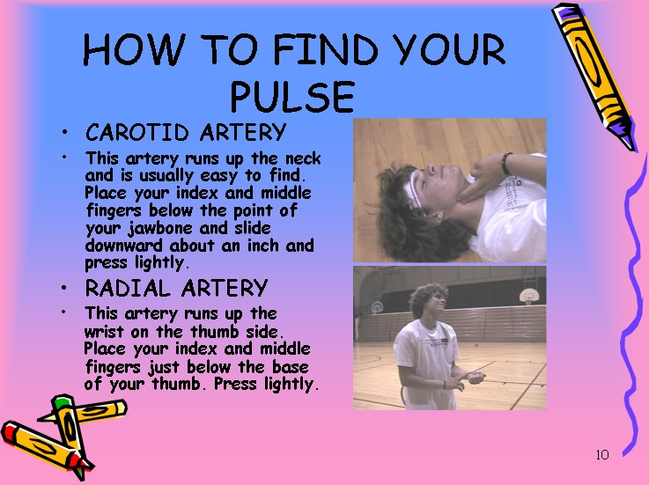

Slide 17
Hypertension and Exercise Position Stand
Emphasis on aerobic activity. VO2R or HRR 40 to 60%. RPE 12-13.
Avoid high-intensity resistance training (lower intensity, higher repetitions).
Clients should maintain hypertensive medications, if prescribed.
Do not exercise if resting SBP > 200 mm Hg or DBP > 115 mm Hg. Maintain BP <220/105 during exercise
Begin pharmacological treatment prior to starting exercise program if BP > 160/100
Diuretics increase the potential for dehydration
Beta-blockers and diuretics impair the ability to regulate body temperature.
S/S of heat illness
Adequate hydration
Proper clothing

Slide 18
Case Study
M/60
Recently diagnosed to have type 2 DM, put on Daonil
BP 160/90 mmHg on metoprolol 50mg bd
Half pack a day smoking habit due to stress of his job
Cholesterol level: 6.2mmol/l , HDL 0.90 mmol/l, LDL 3.8mmol/l
TG: 2.4 mmol/l
No regular exercise
No signs or symptoms of cardiopulmonary disease

Slide 19
Metabolic Syndrome
A constellation of cardiovascular risk factors related to hypertension, abdominal obesity, dyslipidemia, and insulin resistance
Certain drugs used to treat hypertension may accelerate the appearance of new-onset diabetes. In particular, both β blockers and diuretics have been implicated in this effect.

Slide 20
ALLHAT
In high risk hypertensive patients, the diuretic, chlorthalidone, was 43% more likely than the ACEI, lisinopril, to produce diabetes, but was also 18% more likely than the calcium channel blocker, amlodipine, to produce this adverse effect.
HOPE
The development of new diabetes was reduced by 34% (p<0.001) in the ramipril-treated group.
LIFE (Losartan Intervention For Endpoint Reduction in Hypertension)
The ARB, losartan, was associated with a 25% relative risk reduction in new-onset diabetes when compared with the β blocker, atenolol
VALUE (The Valsartan Antihypertensive Long-term Use Evaluation)
Valsartan, was associated with 23% RRR in new-onset diabetes when compared with the calcium channel blocker, amlodipine.

Slide 21
ARB/ACEI may have positive effects on insulin action and potentially plays a meaningful role in protecting high-risk hypertensive patients from developing diabetes.

Slide 22
Medications
Metoprolol changed to ACE inhibitors/ ARB
Metformin
Statin

Slide 23
Will you subject patient to exercise stress test before writing exercise prescription?

Slide 24
Exercise testing
Integral component of the rehab process
Establishment of appropriate specific safety precautions
Guide training intensity
Target exercise training heart rates
Initial levels of exercise training work rates
Risk stratification
Should be performed on all cardiac patients entering an exercise training program

Slide 25
Exercise stress test
METS achieved: 8
VO2max = 28 ml kg-1 min-1
Peak heart rate: 160 beats per minute
Peak blood pressure of 200/88 mmHg.
No exercise induced ischemia

Slide 26
Questions
Please write an initial exercise prescription
Any adjustments and practical tips in patients with DM and HT?

Slide 27
Exercise prescription
Address each of the following
Aerobic endurance
Strength training
Flexibility
Include each of the following in your prescription
frequency
times/day, days/week
Intesnisy
5HRR, %VO2max, %HRmax, %1RM, %MVC, etc
Duration
warm-up, cool-down, exercise component, rest between sets, etc
Mode of exercise
types of exerciise, stretching techniques, resistance training, etc
Rate of progression

Slide 28
Target hear rate zone
HRR (40%)
= (160-60) x 0.4 + 60
= 100
(60%)
=120

Slide 29
Exercise Intensity – Concepts of METs and Ex HR
MET (metabolic equivalent) – A unit of metabolic equivalent, or MET, is defined as the number of calories consumed by an organism per minute in an activity relative to the Basal metabolic rate
1 MET is equivalent to a metabolic rate consuming 3.5 milliliters of oxygen per kilogram of body weight per minute.
1 MET is equivalent to a metabolic rate consuming 1 kilocalorie per kilogram of body weight per hour.

Slide 30
Target VO2
What will be the intensity exercise?
Lower range:
28-3.5 x 0.4 + 3.5= 13.3 ml kg-1 min-1
Higher range:
18.2 ml kg-1 min-1

Slide 31
Recommended work rate
VO2 = (0.1 (speed)) + 1.8 (speed) (grade) + 3.5ml kg-1 min-1
For treadmill grade 2.5%
Speed = 13.3 ml kg-1 min-1/0.145 =91.7m/min or 5.5 kph @2.5%

Slide 32
Simple Estimation of Ex Intensity
Low Intensity: 3-5 METs
Moderate Intensity: 4-7 METs
High Intensity: 8-12 METs
e.g. A 75 kg man plays basketball game for 30 min, Kcal = ?
Kcal = METs x duration x Wt/60 = 8 x 30 x 80/60
= 8 x 30 x 80/60 = 320 KCal

Slide 33
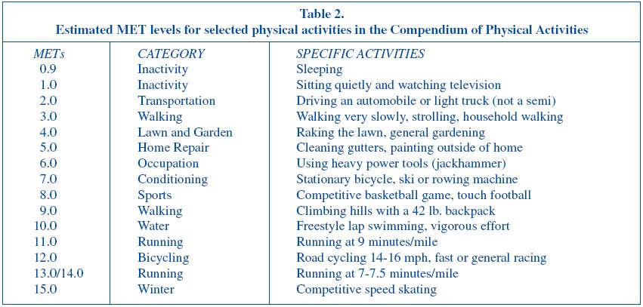
METs: a multiple of the resting rate of oxygen consumption (of a seated individual at rest)
1 MET = 3.5 ml kg⁻¹ min⁻¹ VO₂
Compendium of Physical Activities (MSSE, 1993: 71-80)

Slide 34
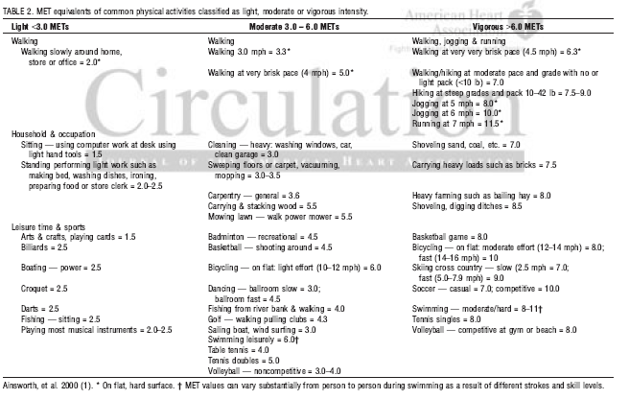

Slide 35
Calculation of calories expenditure
Generic Equation:
Calories (Kcal) = MET x time (min) x body weight (kg)/60
e.g. A 132 lb person would burn 150 Kcal for jogging (5 METs) 30 min.
Kcal = 5 METs x 30 min x 60/60 = 150 KCal

Slide 36
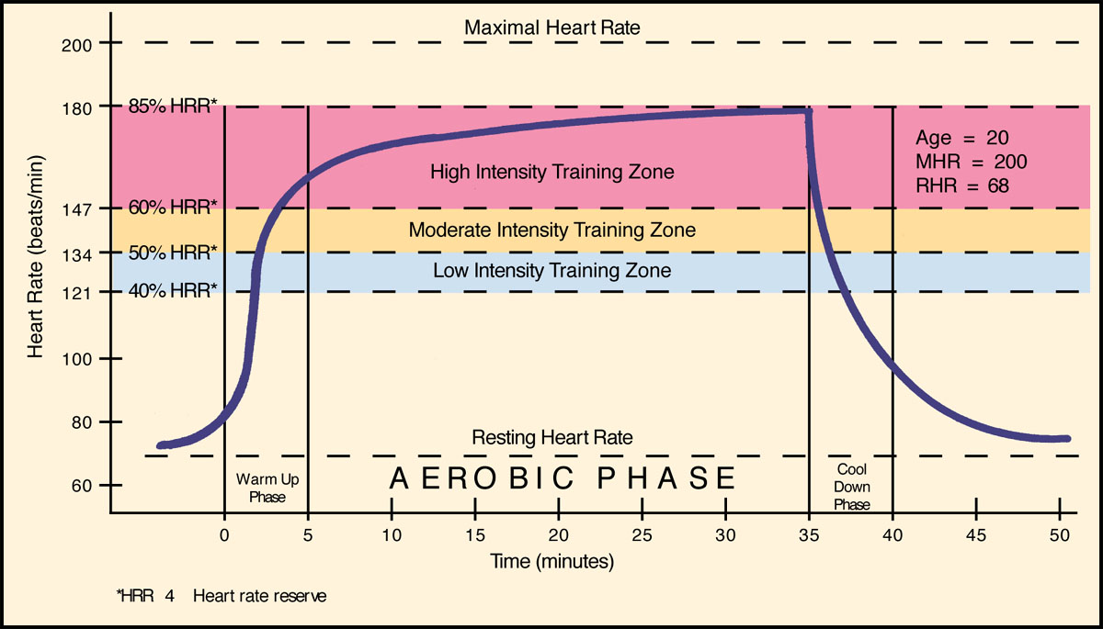
HR Responses During Exercise

